Slide 1
Dignity in AI Ethics
Group 6: Peter Huerta, Aaliyah Jamison, Ishrat Jarin

Slide 2
What is Dignity
According to Immanuel Kant (philosopher):
Negative/Protective Dignity
Positive/Enabling Dignity
Treat humanity always as an end and never only as a means. People must not be treated merely as tools or disposable instruments.
Dignity that involves the right and capacity to take responsibility for one’s own actions — the right not to be treated like a baby or incompetent.

Slide 3
Practical Dignity Cases
Facebook Emotional Contagion Experiment (2012)
Manipulated user emotions via news feed; dignity violation through undisclosed manipulation
OKCupid Experiment (2014)
Manipulated match scores; placebo effect; dignity concerns about user manipulation

Slide 4
Where Does Dignity Come From?
Based on Kant’s Answer: Dignity comes from being a rational, autonomous being. Humans can make moral decisions, act to principles, and take responsibility. You can assume humans have intrinsic worth.
Problem: If dignity comes being rational or based on belief, does it become too broad or too narrow in representation.
Yes, Manipulation “for good” threatens dignity & AI challenges how dignity is defined human worth. However, dignity is a lot harder to measure for each person importance

Slide 5
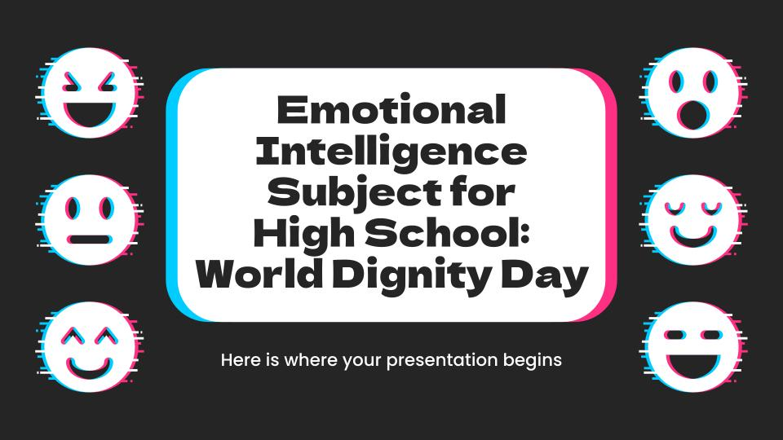
Laborer vs. Computer
When an AI "hires" you to click captchas or trains on your data without consent, it treats you like the computer—a tool to be used until it’s irrelevant.
Case: If I hire you to write me some code, and I buy a computer for you to work with, is there a difference between how I treat you and how I treat the computer?

Slide 6
Practical Definition
All humans have inherent, intrinsic, inalienable value.
We are not commodities, and we are accountable.

Slide 7

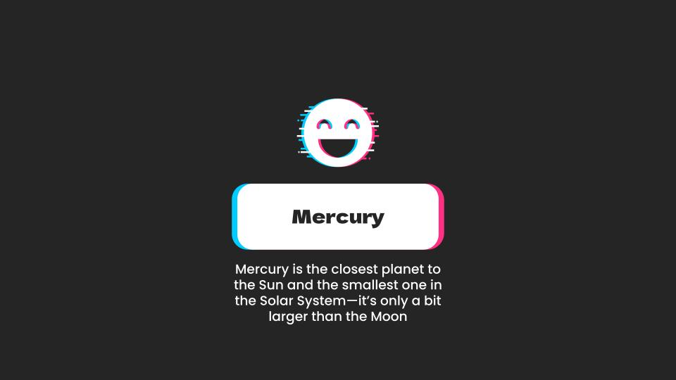
Facebook’s Controversial Feed experiment
Facebook conducted an experiment on its users in which the feeds of their users were altered.
Some users were fed negative content and subjected to negative replies.
As a result their conduct was also negative.
Other users were fed positive content and replies.
Facebook found their users responding positively to others.

Slide 8
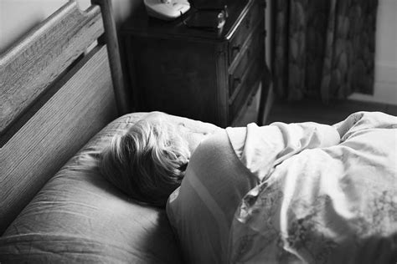
Woebot+Mimetic Ai = Impersonation
Given the effect that technology can have on users we must acknowledge the dilemmas inherent.

Slide 9

Dignity and agency

Slide 10
Woebot+Mimetic Ai = Impersonation
Woebot: chatbot providing CBT-style mental health support; some studies show benefits in reducing depressive symptoms.
Dignity and autonomy:
  Autonomy = capacity to take responsibility for actions.
  AI that replaces all decision-making and emotional labor can erode that capacity.
AI support (like Woebot) can be consistent with dignity if:
  It is an explicit choice by the user (like informed consent vs hidden Facebook experiment).
  It is framed as support, not as a replacement for agency.

Slide 11
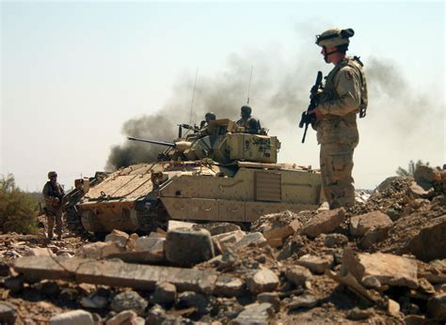
AI & Weapons

Slide 12
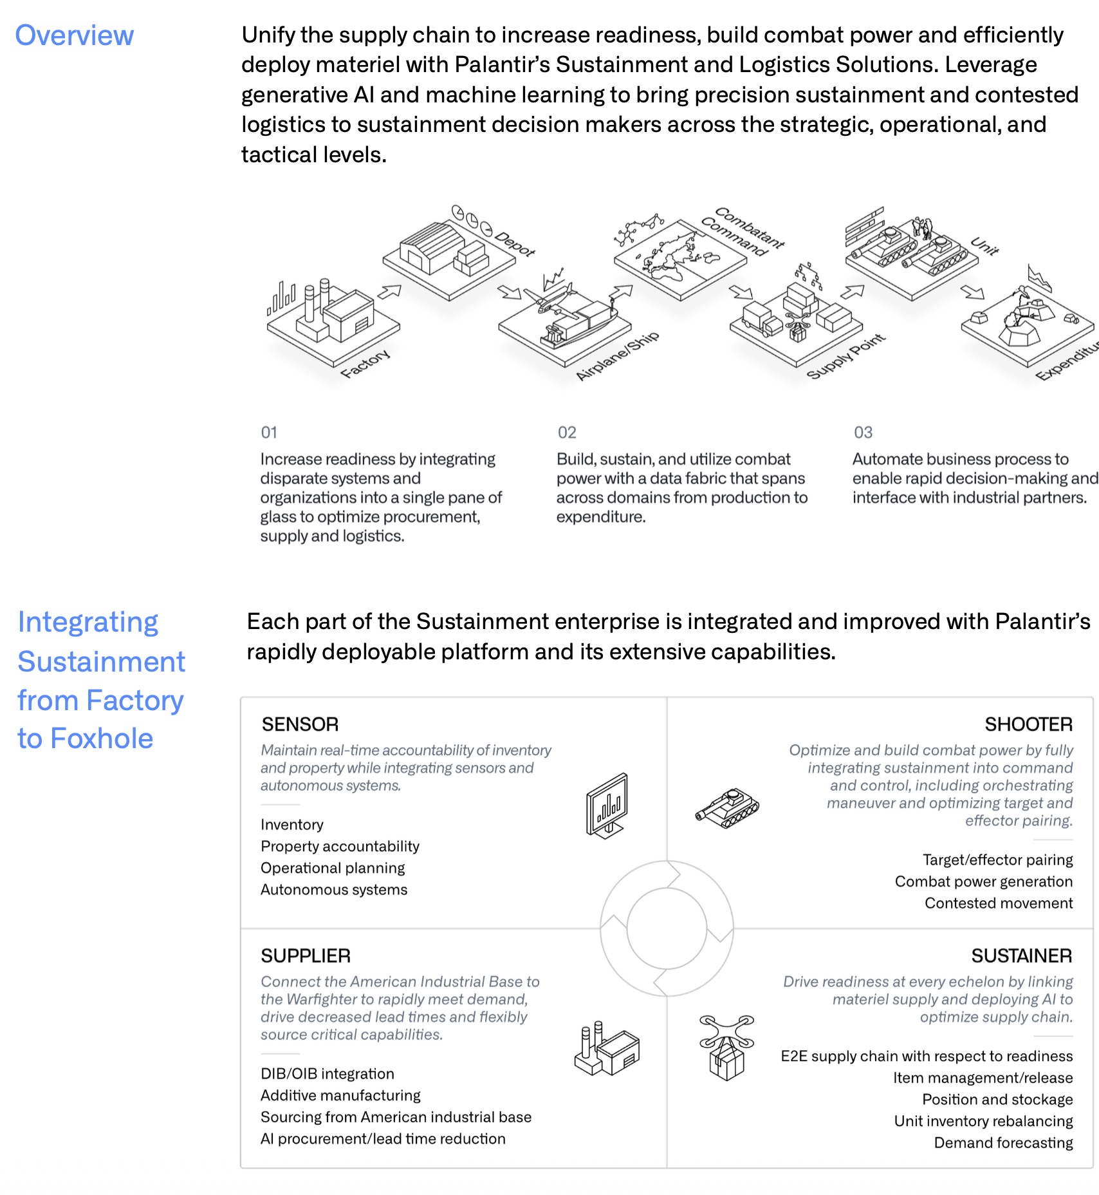
AI & Weapons
Palantir’s Kill Chain
The Technical "Advantages" (Left Side)
Sensor Fusion: AIP integrates data from satellites, drones (ISR), social media, and signals intelligence into a single "Operating Picture."
The F2T2EA Cycle: AI automates the "Find, Fix, Track, Target, Engage, Assess" process. What used to take hours of human analysis now takes seconds.
Predictive Targeting: Using metadata (movement patterns, communications) to assign a "confidence score" to a target.
TITAN (Tactical Intelligence Targeting Access Node): A mobile command center that acts as the "brain," allowing for rapid decision-making at the "edge" of the battlefield.

Slide 13
Dignity Dilemma
The Negative/Protective View: * Commodification: Does reducing a human to a "confidence score" based on metadata violate their protective dignity?
"We kill people based on metadata." If the AI doesn't "know" the person, only their data patterns, it treats the subject as a mere tool/means to a military end.
The Positive/Enabling View:
Accountability Gap: If the AI suggests the target and the human only clicks "confirm" in 0.5 seconds, has the human truly taken responsibility?
Counterfeit Soldiering: Does an AI-driven kill chain remove the "dignity of combat" by turning war into a "calculated campaign of extermination" (as critics argue) rather than a human-led moral decision?

Slide 14
Dignity vs. The "Englishman’s" Happiness
The Concept: Utility vs. Intrinsic Worth
“Man does not strive for happiness; only the Englishman does that.”
In this quote Nietzsche explores the distinction between Utilitarianism and Dignity
  Utilitarianism: Ethics as a math problem. If the AI manipulates 10,000 people to be "happier" (the Facebook experiment), the "sum total" of happiness goes up.
  Dignity: Dignity is indivisible. You cannot trade the dignity of one person to buy the happiness of a million.
Debating utilitarianism versus dignity the question, is it necessary to accept dignity becomes a point of controversy?
Philosophers such as Nietzsche and Kant would find it to be paramount. Arguing that it is an essential component of Humanity.

Slide 15
Where Does Dignity Come From?
  Kant would argue that it does not come from anywhere, It is the intrinsic value of being human. But this is not exactly an answer unless you accept certain premises and ideas that the argument is based on.
  If there was a substrate to Dignity, some candidates might include.
    Self Consciousness
    Intention
    Intelligence
    Body

